Slide 1
Exception Handling

Slide 2
Try, Except
This statement controls how the program proceeds when an error occurs. The syntax is as follows:
try:
do something
except:
do something else when an error occurs
For instance, try running the program below
try:
answer = 12/0
print(answer)
except:
print ("An error occurred")

Slide 3
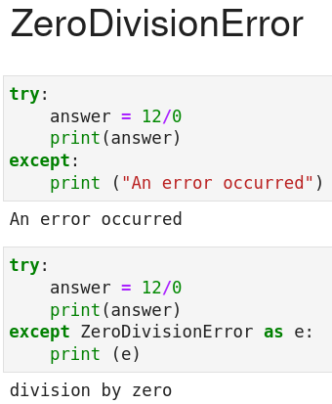
Exception We Saw: ZeroDivisionError

Slide 4
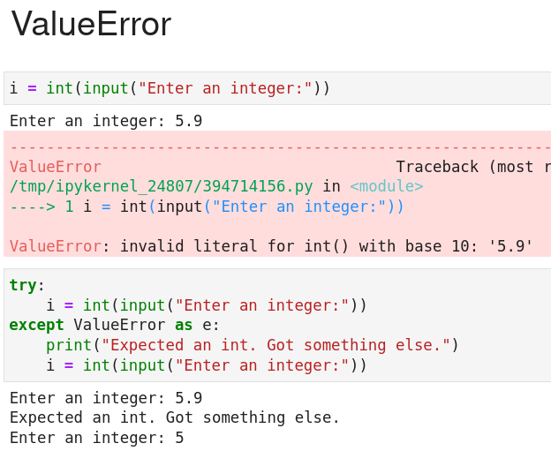
Exception We Saw: ValueError

Slide 5
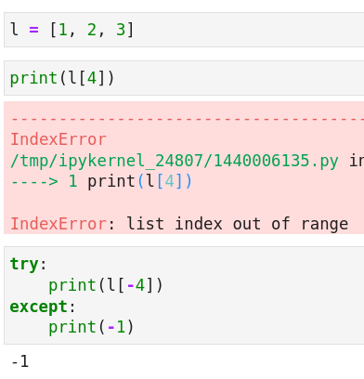
Exception We Saw: IndexError

Slide 6
Getting a default value on index out of range in Python
In the non-Python spirit of "ask for permission, not forgiveness", here's another way:
b = a[4] if len(a) > 4 else '-1'

Slide 7
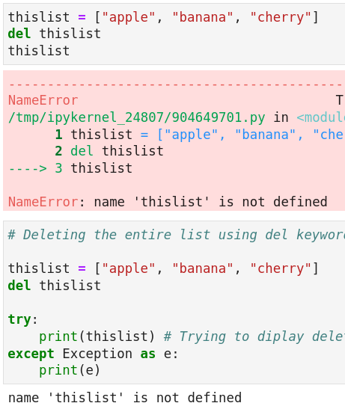
Exception We Saw: NameError
We see this error while working with “del” keyword.

Slide 8
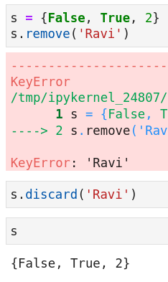
Exception We Saw: KeyError
Use case: We see this exception while working with remove() and discard() methods of a set.

Slide 9
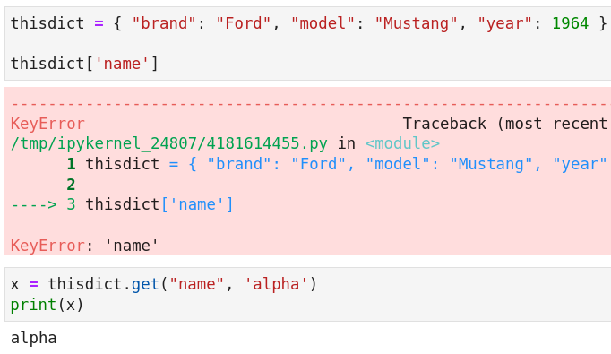
Another example of KeyError While Working With Dict And How to Avoid It

Slide 10
Other common errors in Python
IOError:
Raised when an I/O operation (such as the built-in open() function) fails for an I/O-related reason, e.g., “file not found”.
ImportError: Raised when an import statement fails to find the module definition
IndexError: Raised when a sequence (e.g. string, list, tuple) index is out of range.
KeyError: Raised when a dictionary key is not found.
NameError: Raised when a local or global name is not found.
TypeError: Raised when an operation or function is applied to an object of inappropriate
type.

